Slide 1
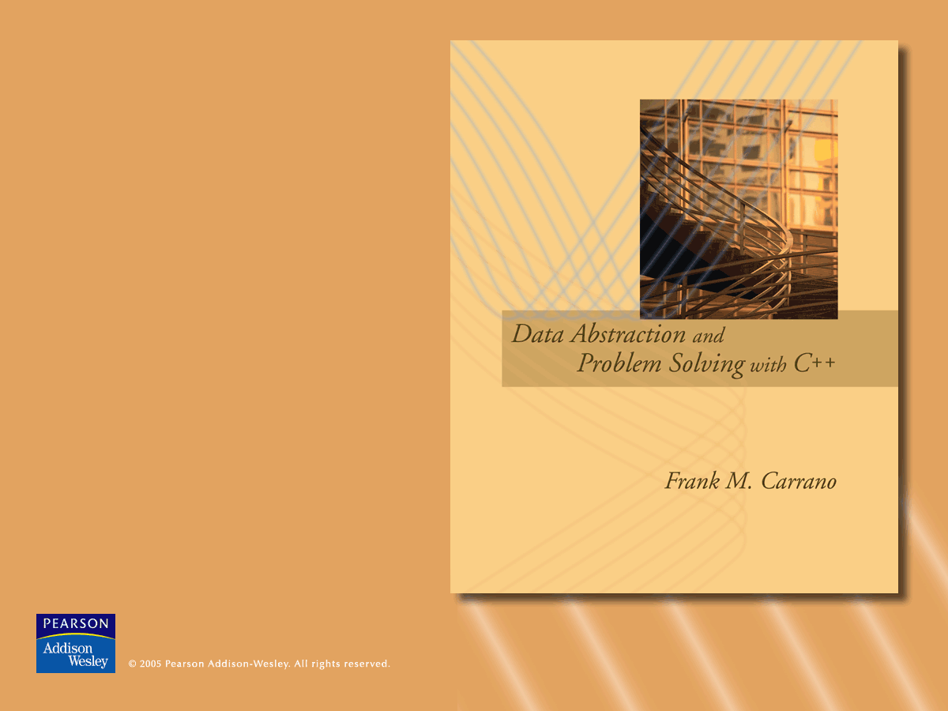
Chapter 5
Recursion as a Problem-Solving Technique

Slide 2

Backtracking
Backtracking
  A strategy for guessing at a solution and backing up when an impasse is reached
Recursion and backtracking can be combined to solve problems
Eight-Queens Problem
  Place eight queens on the chessboard so that no queen can attack any other queen

Slide 3
The Eight Queens Problem
One strategy: guess at a solution
  There are 4,426,165,368 ways to arrange 8 queens on a chessboard of 64 squares
An observation that eliminates many arrangements from consideration
  No queen can reside in a row or a column that contains another queen
    Now: only 40,320 (8!) arrangements of queens to be checked for attacks along diagonals

Slide 4
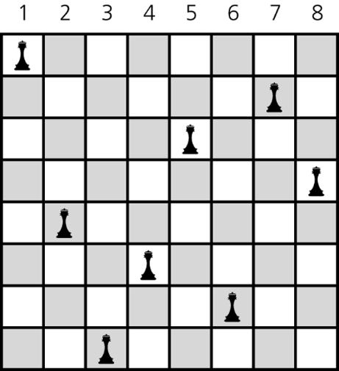
The Eight Queens Problem
Providing organization for the guessing strategy
  Place queens one column at a time
  If you reach an impasse, backtrack to the previous column
Figure 5.2
A solution to the Eight Queens problem

Slide 5
The Eight Queens Problem
A recursive algorithm that places a queen in a column
  Base case
    If there are no more columns to consider
      You are finished
  Recursive step
    If you successfully place a queen in the current column
      Consider the next column
    If you cannot place a queen in the current column
      You need to backtrack

Slide 6
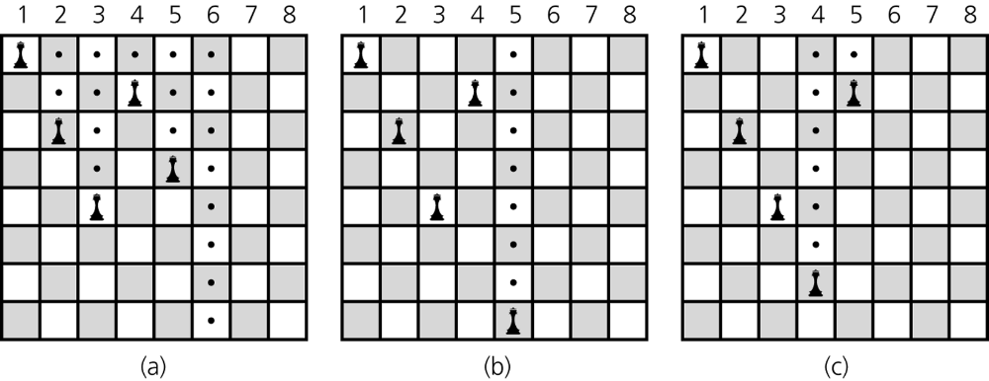
The Eight Queens Problem
Figure 5.1 a) Five queens that cannot attack each other, but that can attack all of column 6; b) backtracking to column 5 to try another square for the queen; c) backtracking to column 4 to try another square for the queen and then considering column 5 again

Slide 7
Implementing Eight Queens Using the STL Class vector
A Board object represents the chessboard
  Contains a vector of pointers to Queen objects on the board
  Includes operations to perform the Eight Queens problem and display the solution
A Queen object represents a queen on the board
  Keeps track of its row and column placement
  Contains a static pointer to the Board

Slide 8
Defining Languages
A language
  A set of strings of symbols
  Examples: English, C++
  If a C++ program is one long string of characters, the language C++Programs is defined as
  C++Programs = {strings w : w is a syntactically correct
  C++ program}

Slide 9
Defining Languages
A language does not have to be a programming or a communication language
  Example: AlgebraicExpressions =
  {w : w is an algebraic expression}
  The grammar defines the rules for forming the strings in a language
A recognition algorithm determines whether a given string is in the language
  A recognition algorithm for a language is written more easily with a recursive grammar

Slide 10
The Basics of Grammars
Symbols used in grammars
  x | y means x or y
  x y means x followed by y
  In x • y, the symbol • means concatenate, or append
  < word > means any instance of word that the definition defines

Slide 11
C++ Identifiers
A C++ identifier begins with a letter and is followed by zero or more letters and digits
Language
C++Ids = {w : w is a legal C++ identifier}
Grammar
  < identifier > = < letter > |
  < identifier > < letter > | < identifier > < digit>
  < letter > = a | b | … | z | A | B | …| Z | _ | $
  < digit > = 0 | 1 | … | 9

Slide 12
C++ Identifiers
Recognition algorithm
  isId(in w:string): boolean
  if (w is of length 1)
  if (w is a letter)
  return true
  else
  return false
  else if (the last character of w is a letter
  or a digit)
  return isId(w minus its last character)
  else
  return false

Slide 13
Palindromes
A string that reads the same from left to right as it does from right to left
Language
  Palindromes = {w : w reads the same left to right
  as right to left}
Grammar
  < pal > = empty string | < ch > | a < pal > a |
  b < pal > b | …| Z < pal > Z
  < ch > = a | b | … | z | A | B | … | Z

Slide 14
Palindromes
Recognition algorithm
  isPal(in w:string):boolean
  if (w is the empty string or
  w is of length 1)
  return true
  else if (w’s first and last characters are
  the same letter )
  return isPal(w minus its first and last
  characters)
  else
  return false

Slide 15
Strings of the Form A^{n}B^{n}
A^{n}B^{n}
  The string that consists of n consecutive A’s followed by n consecutive B’s
Language
  L = {w : w is of the form A^{n}B^{n} for some n ≥ 0}
Grammar
  < legal-word > = empty string |
  A < legal-word > B

Slide 16
Strings of the form A^{n}B^{n}
Recognition algorithm
  isAnBn(in w:string):boolean
  if (the length of w is zero)
  return true
  else if (w begins with the character A and ends with the character B)
  return isAnBn(w minus its first and last characters)
  else
  return false

Slide 17
Algebraic Expressions
Infix expressions
  An operator appears between its operands
    Example: a + b
Prefix expressions
  An operator appears before its operands
    Example: + a b
Postfix expressions
  An operator appears after its operands
    Example: a b +

Slide 18
Algebraic Expressions
To convert a fully parenthesized infix expression to a prefix form
  Move each operator to the position marked by its corresponding open parenthesis
  Remove the parentheses
  Example
    Infix expression: ((a + b) * c
    Prefix expression: * + a b c

Slide 19
Algebraic Expressions
To convert a fully parenthesized infix expression to a postfix form
  Move each operator to the position marked by its corresponding closing parenthesis
  Remove the parentheses
  Example
    Infix form: ((a + b) * c)
    Postfix form: a b + c *

Slide 20
Algebraic Expressions
Prefix and postfix expressions
  Never need
    Precedence rules
    Association rules
    Parentheses
  Have
    Simple grammar expressions
    Straightforward recognition and evaluation algorithms

Slide 21
Prefix Expressions
Grammar
  < prefix > = < identifier > | < operator >
  < prefix > < prefix >
  < operator > = + | - | * | /
  < identifier > = a | b | … | z
A recognition algorithm
  isPre():boolean
  lastChar = endPre(0) // returns the end
  return (lastChar >=0 and
  lastChar == strExp.length() -1)

Slide 22
Prefix Expressions
An algorithm that evaluates a prefix expression
  evaluatePrefix(inout strExp:string):float
  ch = first character of expression strExp
  Delete first character from strExp
  if (ch is an identifier)
  return value of the identifier
  else if (ch is an operator named op) {
  operand1 = evaluatePrefix(strExp)
  operand2 = evaluatePrefix(strExp)
  return operand1 op operand2
  }

Slide 23
Postfix Expressions
Grammar
  < postfix > = < identifier > |
  < postfix > < postfix > < operator>
  < operator > = + | - | * | /
  < identifier > = a | b | … | z
The recursive case for prefix form to postfix form conversion
    postfix(exp)= postfix(prefix1) +
    postfix(prefix2) + <operator>

Slide 24
Postfix Expressions
A recursive algorithm that converts a prefix expression to postfix form
  convert(inout pre:string, out post:string)
  ch = first character of pre
  Delete first character of pre
  if (ch is a lowercase letter)
  post = post + ch
  else {
  convert(pre, post)
  convert(pre, post)
  post = post + ch
  }

Slide 25
Fully Parenthesized Expressions
Fully parenthesized expressions
  Do not require precedence rules or rules for association
  Are inconvenient for programmers
Grammar
  < infix > = < identifier > |
  (< infix > < operator > < infix > )
  < operator > = + | - | * | /
  < identifier > = a | b | … | z

Slide 26
Recursion and Mathematical Induction
Recursion and mathematical induction
  Both use a base case to solve a problem
  Both solve smaller problems of the same type to derive a solution
Induction can be used to
  Prove properties about recursive algorithms
  Prove that a recursive algorithm performs a certain amount of work

Slide 27
The Correctness of the Recursive Factorial Function
Pseudocode for the recursive factorial
  if (n is 0)
  return 1
  else
  return n * fact(n – 1)
Induction on n proves the return values:
  fact(0) = 0! = 1
  fact(n) = n!= n*(n – 1)*
  (n – 2)*…* 1 if n > 0

Slide 28
The Cost of Towers of Hanoi
Solution to the Towers of Hanoi problem
  solveTowers(count, source, destination, spare)
  if (count is 1)
  Move a disk directly from source to
  destination
  else {
  solveTowers(count-1, source, spare, destination)
  solveTowers(1, source, destination, spare)
  solveTowers(count-1, spare, destination, source)
  }

Slide 29
The Cost of Towers of Hanoi
With N disks, how many moves does solveTowers make?
Let moves(N) be the number of moves made starting with N disks
When N = 1
  moves(1) = 1
When N > 1
  moves(N) = moves(N–1)+ moves(1)
  + moves(N–1)

Slide 30
The Cost of Towers of Hanoi
Recurrence relation for the number of moves that solveTowers requires for N disks
  moves(1) = 1
  moves(N) = 2 * moves(N – 1) + 1
  if N > 1

Slide 31
The Cost of Towers of Hanoi
A closed-form formula is more satisfactory
  You can substitute any given value for N and obtain the number of moves made
  moves(N) = 2^{N} – 1, for all N ≥ 1
  Induction on N can provide the proof that moves(N) = 2^{N} – 1

Slide 32
Summary
Backtracking is a solution strategy that involves both recursion and a sequence of guesses that ultimately lead to a solution
A grammar is a device for defining a language
  A language is a set of strings of symbols
  A recognition algorithm for a language can often be based directly on the grammar of the language
  Grammars are frequently recursive

Slide 33
Summary
Different languages of algebraic expressions have their relative advantages and disadvantages
  Prefix
  Postfix
  Infix
Induction can be used to prove properties about a recursive algorithm

